Slide 1

GLOBE Asia Pacific Regional Meeting
March 10-14, 2023
Hanoi, Vietnam
Yogendra Chitrakar

Slide 2


ECCA Brief
Established in 1987 as a non-profit, nonpolitical, non-govt. org.
Pioneered the concept of children’s nature club (in Nepal) in1992
Awards:
1991 and 2001 by the Government of Nepal
1993, International Rolex Award (for ECCA’s unique methodology)
2005, Global Development Marketplace (for Solar Tuki), World Bank, Washington DC, USA
2007, Tech Museum Awards (category Economic Development) (for Solar Tuki), The Tech Museum of Innovation, California, USA
2008, Nepal Development Marketplace (for safe drinking water campaign)
2014, Nature Conservation Award, Nepal Academy of Science and Technology (NAST)

Slide 3

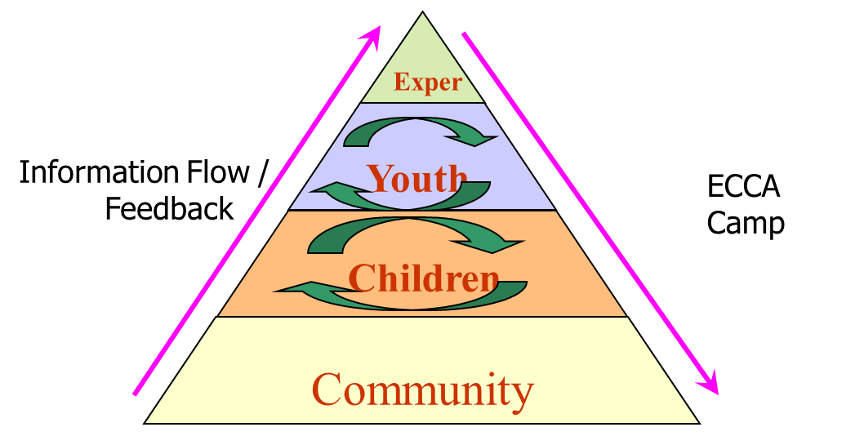



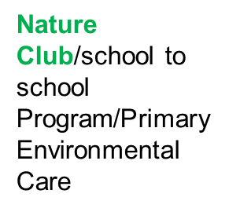
ECCA Mission and Methodology
ECCA shall be a Professional Volunteer Organization dedicated to securing a sound ecological future
ECCA shall create a platform for youths and school children to lead positive change in environmental conservation and community development
ECCA shall support the development of conservation-related entrepreneurship

Slide 4
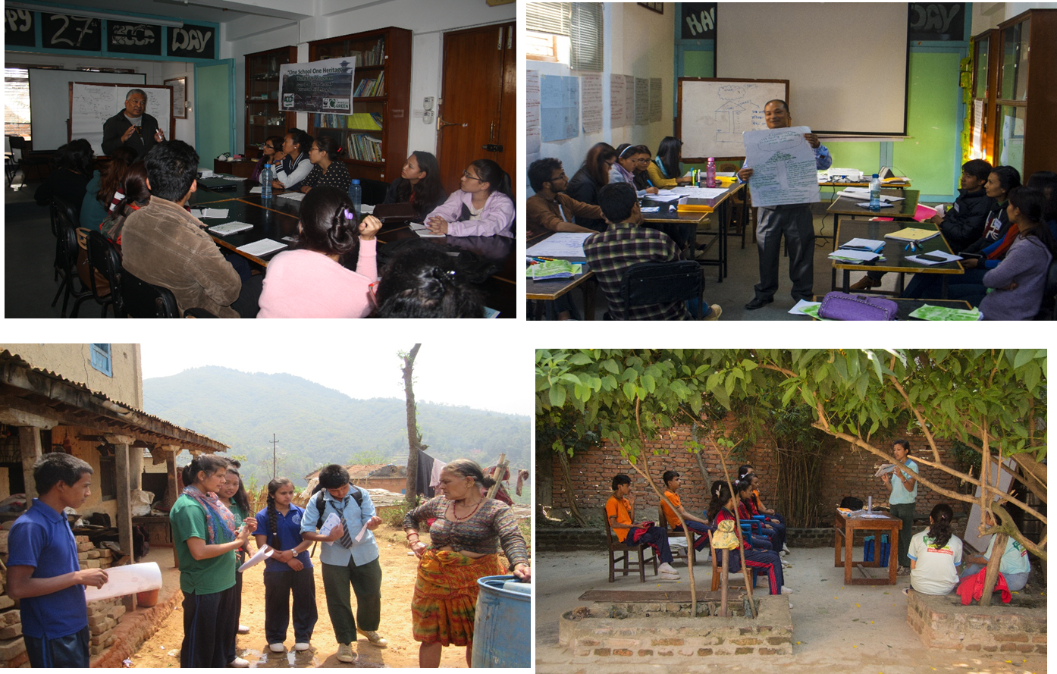


Approach

Slide 5
Field of Work
Environment, Climate Change, Disaster Management, Natural Resource Management, Nutrition, Food Security, Enhancing Livelihood
Education for Sustainable Development and School Environment Improvement
Child rights and development
Appropriate Technology / Renewable Energy
Water, Sanitation and Hygiene (WASH)
Redevelopment and Reconstruction

Slide 6
GLOBE Current Status
Launched: March 3, 2000
Cooperating Organizations
  ECCA – Country Coordinator
  Government & Private Schools
  different stakeholders according to the needs and projects
Participation
  20 Schools
  The current Focus is on 5 Private schools (1 school in East Nepal and 4 schools within the valley) and 15 other government schools.
  Number of Schools Reporting Data over the Past Year: only 5 schools
Funding Status
  ECCA Self Funding integrating with different programs and project activities.
Protocols Implemented
  Atmosphere – training and data entry
  Hydrology – training and data entry
  Land coverage only training
  Mosquito

Slide 7


Program Implementation, International Cooperation in GLOBE Network, and Activities over Past Year (categorized by GLOBE Strategic Plan 2018-2023 Goals):

Slide 8
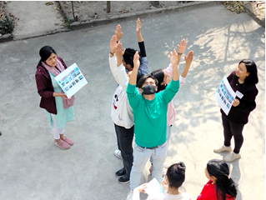
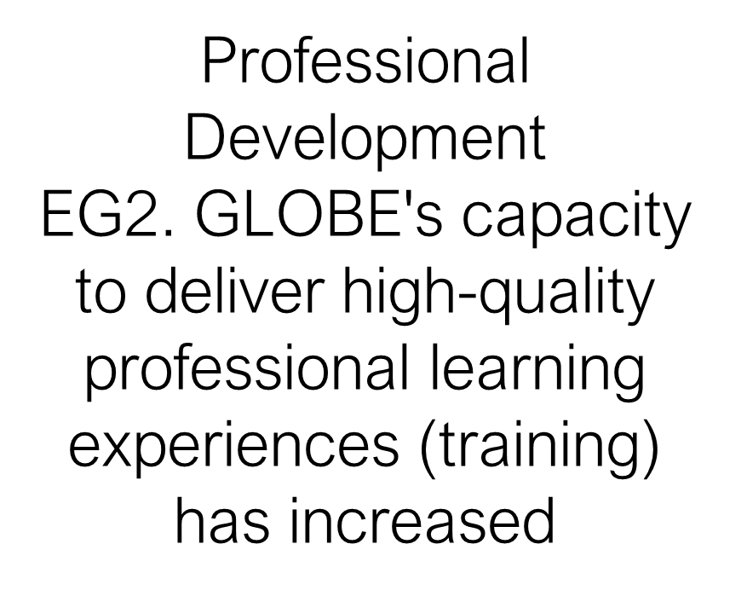
1. Education
GLOBE Program awareness training for around 40 youths and teachers and 60 students with 15 school teachers. Where the trained youth support training school students. (To know, to do, to sustain approach)
Youth Training Program – One-day GLOBE training in March 2022 for 24 youth from different colleges and 19 youths on March 23.
ECCA Camp – GLOBE on June 8, 2022, One of GLOBE’s schools shared its GLOBE activities with other 6 schools Program Officer from US Embassy visited one of GLOBE’s schools in Jhapa, Amity Secondary School.
The youth or GLOBE alumni have been supporting GLOBE activities whenever required.

Slide 9

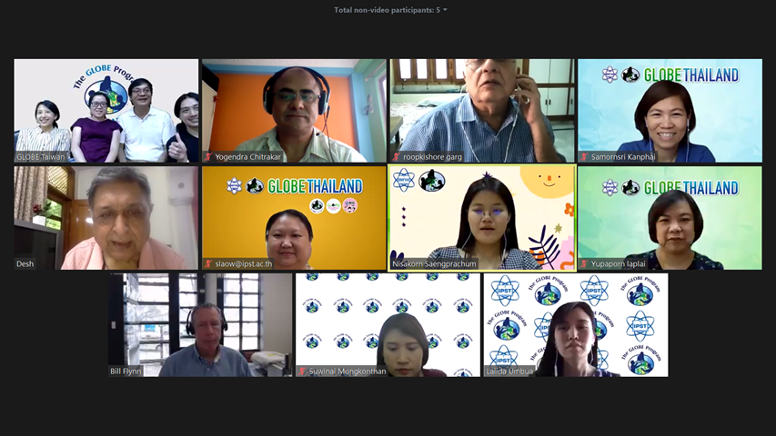
ECCA engaged them in training, expeditions, online webinars, etc. Three youth GLOBE trainers were involved in Pokhara Expedition. GLOBE Nepal was involved as a trainer in Bhutan Online GLOBE teachers’ training in April 2022.
GLOBE schools’ teachers, students, and GLOBE trainers and alumni participated in different online/virtual capacity-building webinars organized by RCO.

Slide 10
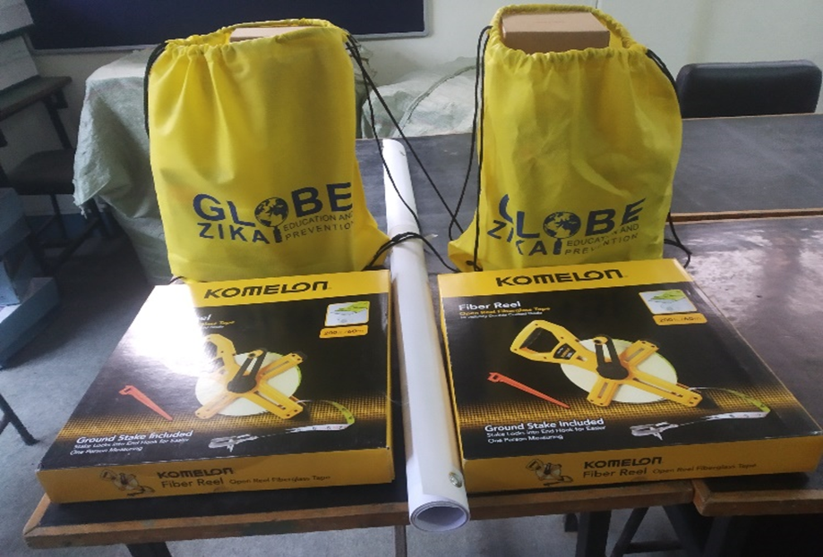
2. Science
Student Investigations
EG3: Students develop high-quality STEM investigations of Earth systems phenomena from a local to global scale perspective.
Science Projects
SG4. Increase the number of projects focused on environmental awareness and contributing to environmental benefits:
After the support from GLOBE plus program, all supported schools started doing science research using GLOBE protocols which were presented in APR webinars, and submitted their artifacts in different forums. It has enhanced the schools to do science and interest in STEM education and integrated it into their subject lesson activities.

Slide 11
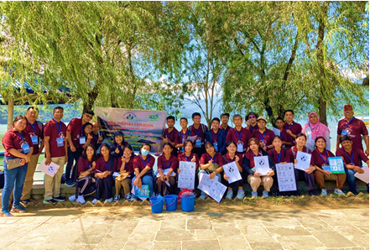
Community
The engagement of schools in GLOBE programs and their activities are reflected in different forums like GLOBE webinars and GLOBE Star reports on the GLOBE website. Besides, they are planning to share their works through IVSS.
ECCA hosted the Pokhara Lake Expedition from September 27 to October 3, 2022, with 40 students and teachers from seven different GLOBE countries. A NASA media team of three visited to develop the Lake Expedition video, which will be shared in the GLOBE community in the future. Likewise, there were representatives from US Embassies in Nepal and Bangladesh to understand the GLOBE program.
EG4. Information on GLOBE’s educational impact is regularly shared by the community:
Interactions and Collaboration
CG2. Increase interactions and collaborations among local, regional, and international GLOBE communities through events and activities.

Slide 12
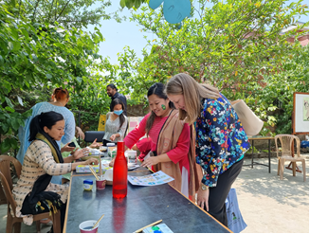
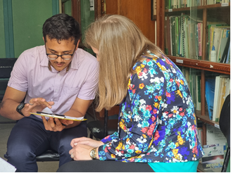
GLOBE youth organized the program for EARTH Day 2022 on April 22 which different college youth were invited. They showcased different environmental activities, exhibitions, poem competitions, and games where Ms. Laura Djuragic, Regional ESTH Officer for South Asia visited and interacted with youth on the GLOBE program to understand how they have been doing GLOBE in Nepal.

Slide 13
4. Technology
ECCA encourages their GLOBE Students and GLOBE observation & enter data, but still, there is less data entry though they do GLOBE activities regularly.
ECCA emphasizes the training of teachers & students on the GLOBE webpage & use of GLOBE Science Data Visualization to develop research projects.
ECCA also proposed encouraging students & teachers to observe and use GLOBE data to prepare research projects.
In this section, ECCA needs to work more to make schools easy on data entry.
Data Systems
TG1. The use of GLOBE data systems (data collection, data entry, visualizations, ADAT, and retrieval) has increased

Slide 14
5. Communications
Interactions and Collaboration
CG2. Increase interactions and collaborations among local, regional, and international GLOBE communities through events and activities.
Communication Pathways
CMG1. Improve the communication pathways among the GLOBE community
Nepal schools, students, and GLOBE trainers are in the communication link through AP GLOBE Messenger Group, email, and another separate messenger group who participated in different programs.
There were two sharing meetings on the GLOBE program in Nepal with Mr. Patrick S. Gan, Regional ESTH officer for South Asia, one in the ECCA office on September 16, 2022and another in US Embassy on December 13, 2022

Slide 15
Plans and Ideas for 2023/2024:
1. GLOBE training program for youth – March/April/May 2023/ 2024
2. GLOBE training program for students – April/May/June 2023/2024
3. Refresher training on GLOBE for teachers and students – November/December 2023
Lake Expedition Exchange Program – April end 2023 / September 2023
National Child Club Conference – April/May 2024

